Slide 1
Al-BASED TOOL FOR PRELIMINARY DIAGNOSIS OF DERMATOLOGICAL MANIFESTATIONS
CSE7101- Capstone Project
Review-3
Batch Number: CSE_4
Under the Supervision of,
Mr. Jerrin Joe Francis
Assistant Professor
School of Computer Science and Engineering
Presidency University
Roll Number | Student Name
20221CSE0374 | LAKSHMI PRIYA NARAYAN
20221CSE0046 | HEMANTH K
20221CSE0045 | VANKAM VISWA SAI
Name of the Program: BTech-Computer Science and Engineering
Name of the HoD: Dr. Asif Mohammed
Name of the Program Project Coordinator: Dr. Jayavadivel Ravi
Name of the School Project Coordinators: Dr. Sampath A K , Dr. Geetha A

Slide 2
Contents
Abstract
Literature Survey
Objectives
Existing Methods & Drawbacks
Proposed Method & Feasibility
Architecture Diagram
Modules
Hardware & Software
Timeline (Gantt Chart)
References

Slide 3
Abstract
The timely and accurate diagnosis of dermatological diseases remains a critical challenge in global healthcare, threatening patient outcomes due to delayed assessments and a shortage of specialists.
Traditional visual diagnostic methods are often subjective and fail to provide scalable, immediate support, particularly in non-specialist clinical settings. This project develops an AI-powered diagnostic platform for dermatological analysis, leveraging deep learning to classify various skin conditions from clinical images.
The system combines a robust Convolutional Neural Network (CNN) for multi-class identification of diseases, a user-friendly interface for seamless image submission, and Explainable AI (XAI) to enhance diagnostic transparency.
By providing rapid, data-driven insights, the platform acts as a powerful decision support tool, aiming to improve diagnostic accuracy, increase patient access to preliminary screenings, and foster a culture of early detection in dermatological care.

Slide 4
Literature Survey
Ref No | Title of the paper | Name of the Author and Year | Method used | Merits | Demirits
1 | JILDYA-Net: An Efficient Lightweight Multi-Class Classification Architecture for Skin Lesions | Ayoub Laouarem, et al. (2025) | Dataset used:HAM10000, ISIC-2019 Model used:JILDYA-Net (ASFE, FNet encoder, EAM) Accuracy %:98.80% (HAM10000), 95.10% (ISIC-2019) | Outperforms state-of-the-art models in accuracy and efficiency, | The model's performance can be sensitive to class imbalance and small datasets, and its lightweight architecture may struggle with highly complex scenarios.
2 | Self-attention transformer unit-based deep learning framework for skin lesions classification in smart healthcare | Khosro Rezaee & Hossein Ghayoumi Zadeh (2024) | Dataset used:ISIC-2019, PH² Model used:Bi-branch (Transformer module, SAU, optResNet-18) Accuracy %:97.48% (ISIC-2019), 96.87% (PH²) | Achieves very high accuracy (97.48% on ISIC-2019) by effectively combining the strengths of both Transformer and CNN architectures. | Performance is sensitive to insufficient training data, varied imaging conditions, and artifacts like human hair.
3 | Quantization-Aware Neuromorphic Architecture for Efficient Skin Disease Classification on Resource-Constrained Devices | Haitian Wang, et al. (2025) | Dataset used:HAM10000, clinical dataset (Hospital Sultanah Bahiyah) Model used:QANA (Spiking Neuromorphic SNN on Akida) Accuracy %:91.6% (HAM10000), 90.8% (clinical) | Delivers extremely low latency (1.5 ms) and energy use (1.7 mJ), reducing both by over 94% compared to GPU-based CNNs. | The complex CNN-to-SNN conversion process can lead to accuracy loss, especially on small or imbalanced medical datasets.
4 | Detection and classification of skin diseases with ensembles of deep learning networks in medical imaging | A. Kalaivani & Dr. S. Karpagavalli (2022) | Dataset used:HAM10000 Model used:RF-DCNN (ensemble of Random Forest and CNN) Accuracy %:96.1% | Achieved a higher accuracy of 96.1% compared to using a single, classical CNN classifier alone. | The combined model has a longer prediction time, is more difficult to interpret, and can suffer from overfitting.
5 | Multi-Class Skin Problem Classification Using Deep Generative Adversarial Network (DGAN) | Maleika Heenaye-Mamode Khan, et al. (2022) | Dataset used:Custom (13,650 images: PH², SD-198, DermNet) Model used:DGAN (Deep Generative Adversarial Network) Accuracy %:92.3% (labelled), 91.1% (unlabelled) | Successfully addresses limited and imbalanced datasets, outperforming traditional augmentation by achieving 92.3% accuracy on labeled data. | A main challenge is improving the stability of the DGAN model during training, which is a common issue for GANs.

Slide 5
Literature Survey
Ref No | Title of the paper | Name of the Author and Year | Method used | Merits | Demerits
6 | Explainable AI for Skin Disease Classification Using Grad-CAM and Transfer Learning to Identify Contours | S M Saiful Islam Badhon, et al. (2024) | Dataset used:Self-collected (5,182 images, rare skin diseases) Model used:Transfer learning: VGG-16, VGG-19, GoogleNet, Inception, Xception; best: VGG-16 (with augmentation) Accuracy%:97.07% (VGG-16, balanced), 95.00% (VGG-19, imbalanced) | Improves trust and interpretability by using Grad-CAM to create visual heatmaps that explain the model's predictions. | The performance of some tested models was very poor on imbalanced data before proper data augmentation was applied.
7 | EFFICACY OF SMARTPHONE-COMPATIBLE OPTICAL INSTRUMENT FOR ASSESSING MELANOCYTIC NEVI FOR MALIGNANCY | Gaydina TA, Dvornikova EG (2020) | Dataset used:Clinical data, 7 patients, 74 surgically removed nevi. Model used:Handyscope optical system, Handyscope3 mobile application, Convolutional Neural Network (CNN). Accuracy%:100%. | The smartphone-compatible optical system is a real time-saver for both the physician and the patient, offering a portable and convenient method for monitoring melanocytic nevi | The primary disadvantage is that the AI assessment serves only as a screening tool, as histopathological verification of the diagnosis is still needed for confirmation.
8 | AI in Oncology: Transforming Cancer Detection through Machine Learning and Deep Learning Applications | Muhammad Aftab, Faisal Mehmood, Chengjuan Zhang, et al. (2025) | Dataset used:Medical Imaging, Genomic and Multi-omics Data, Pathology Images, ISIC 2016, 2017, 2019, 2020, PH2, HAM10000, and Xiangya-Derm. Model used:AlexNet, VGG16, VGG19, ResNet50V2, ResNet101, InceptionV3, InceptionResNetV2, Xception, DenseNet201, MobileNetV2, and NASNet. Accuracy%:98.33% | Enhanced Diagnostic Precision, Early Detection, Efficiency and Cost Reduction | Bias in Data, Lack of Interpretability, Ethical and Regulatory Concerns
9 | AI-Powered IoMT Framework for Remote Triage and Diagnosis in Telemedicine Applications | Sura Saad Mohsin, et al. (2025) | Dataset usedSimulated/virtual scenario data, 250 patients,Chronic heart disease, Hypertension, Stroke Model AI-Powered IoMT Framework (RIDF) Rule-based algorithms IF-THEN rules Accuracy%:98.4% | The framework provides a more comprehensive assessment by integrating both sensory (e.g., SpO2, blood pressure) and non-sensory (e.g., medical history) patient data. It simultaneously performs both triage and preliminary diagnosis | The evaluation was conducted in a simulated environment on a relatively small dataset of 250 patients and requires more validation in real-life clinical settings
10 | A comparative analysis of lesional skin, sentinel flap, and mucosal biopsies in assessing acute face transplant rejection | Martin Kauke-Navarro, et al. (2025) | Dataset used:Retrospective clinical: face transplant biopsies (47 mucosal/skin, 37 skin/sentinel flap) Model used:Statistical analysis (Pearson's, ROC) Accuracy%:Sensitivity 0.85 (mucosa predicting skin rejection); no classification accuracy in AI sense | The study concludes that mucosal biopsies are more sensitive and can detect rejection events missed by skin biopsies alone, suggesting they should be a routine part of monitoring. | The primary limitations are a very small sample size (nine patients), which restricts the generalizability of the findings, and that sentinel flaps were found to be unreliable for monitoring rejection.

Slide 6
Objective
Build a robust CNN model to accurately classify multiple skin diseases from clinical images.
Develop a secure and user-friendly interface for seamless image submission and rapid analysis.
Integrate Explainable AI (XAI) to provide visual insights into diagnostic decisions and build clinical trust.
Validate the model's performance against benchmark datasets using key metrics like accuracy and precision.
Special focus on building a model suitable specifically for Indian skin tone.

Slide 7
Classes
Melanocytic Nevi (NV)
Benign Keratosis-like Lesions (BKL)
Dermatofibroma (DF)
Vascular Lesions (VASC)
Actinic Keratoses (AKIEC)
Basal-Cell Carcinoma (BCC)
Melanoma (MEL)

Slide 8
Existing Methods and Drawbacks
EXISTING METHODS:
In-person visual examination by a general
practitioner or a dermatologist.
Use of specialized tools like a dermatoscope
for magnified inspection.
Reliance on clinician's personal experience
and pattern recognition skills.
Invasive skin biopsy and subsequent histopathological
analysis for definitive diagnosis.
Consultation of medical textbooks and static
online databases by non-specialists.
DRAWBACKS:
Limited access to specialists and long patient
wait times.
High risk of misdiagnosis due to subjective,
experience-dependent evaluations.
Slow diagnostic process, with biopsy results
causing critical treatment delays.
Procedures like biopsies are invasive, costly, and
can cause scarring.
Not scalable for rapid, large-scale population screening.

Slide 9
Proposed Methods and Feasible Study
Proposed Method
AI-Powered Diagnostic Tool: A digital platform that utilizes a deep learning model
to analyze and classify skin lesion images.
User-Friendly Clinical Interface: A secure web or mobile application for seamless
image submission and review of diagnostic results by healthcare professionals
Explainable AI (XAI) for Transparency: Integration of visualization tools to provide
clear insights into the AI's diagnostic reasoning, enhancing clinical trust.
Feasible Study
1.Technology
Utilizes established and widely available technologies like Python, deep learning
frameworks (TensorFlow/PyTorch), and cloud services.
2.Cost Effectiveness
Leverages open-source deep learning libraries and scalable cloud-based solutions to
minimize development and infrastructure costs.
3.Resources
Requires minimal human resources for operation after initial setup;
the automated analysis can be maintained by a small technical team.
Highly scalable to accommodate a growing number of users and diagnostic
requests using modern cloud infrastructure.

Slide 10
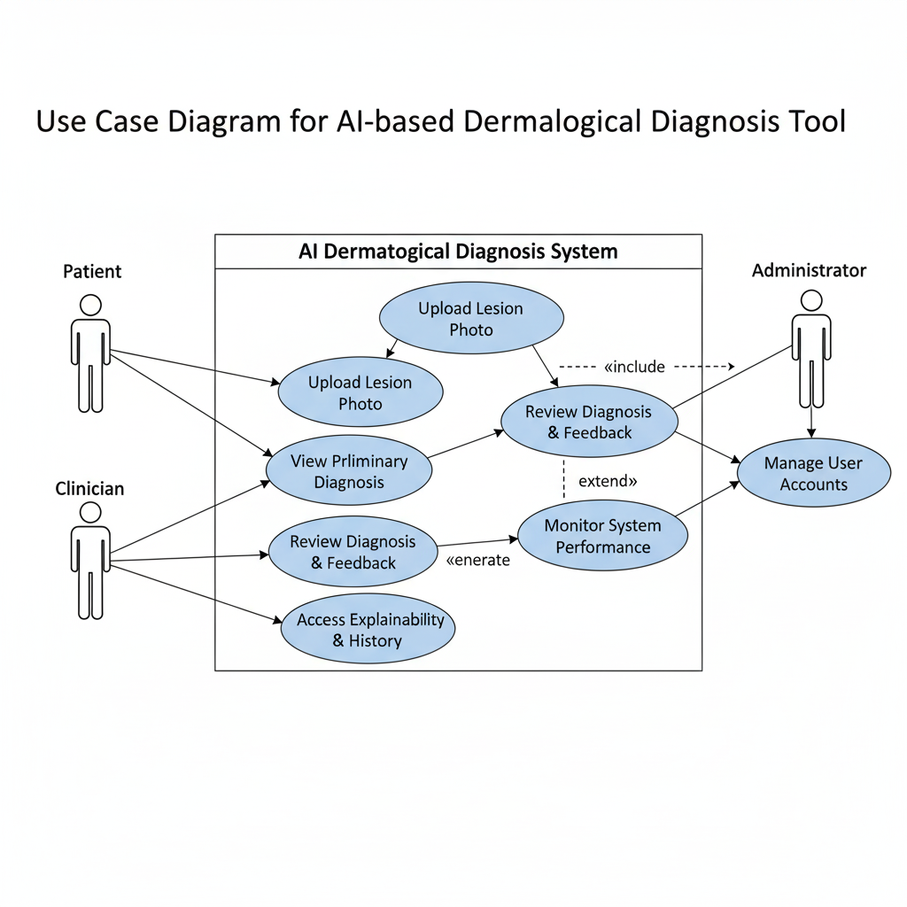
Architecture Diagram

Slide 11
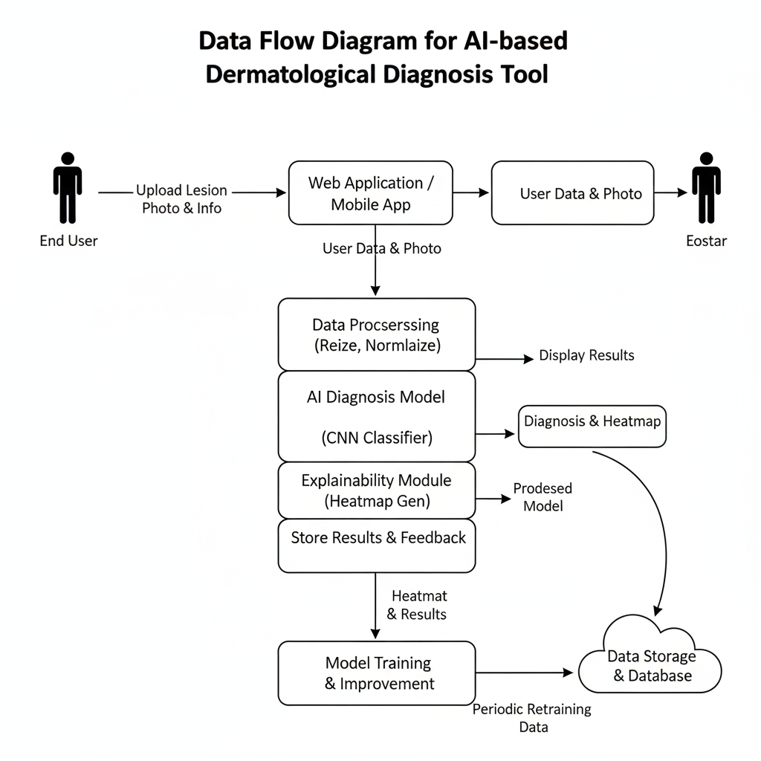
Architecture Diagram

Slide 12
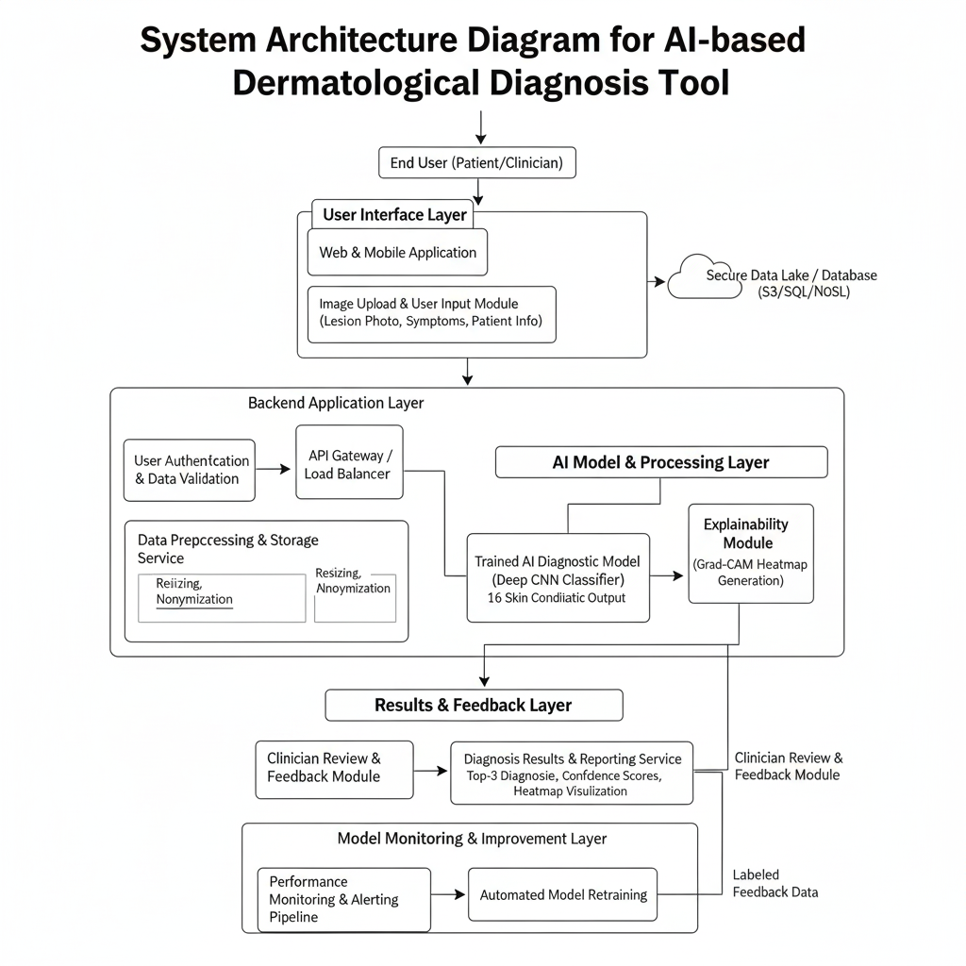
Architecture Diagram

Slide 13
Modules
Our proposed system is designed with a modular architecture to ensure clarity and scalability. The key modules are:
User Interface (UI) & Image Upload Module:
Functionality: Provides a clean, user-friendly web interface for healthcare workers to securely upload an image of a patient's skin lesion.
Image Preprocessing Module:
Functionality: Automatically receives the uploaded image and prepares it for the AI model. This includes resizing to the required input dimensions, normalization of pixel values, and any necessary cropping or enhancement.

Slide 14
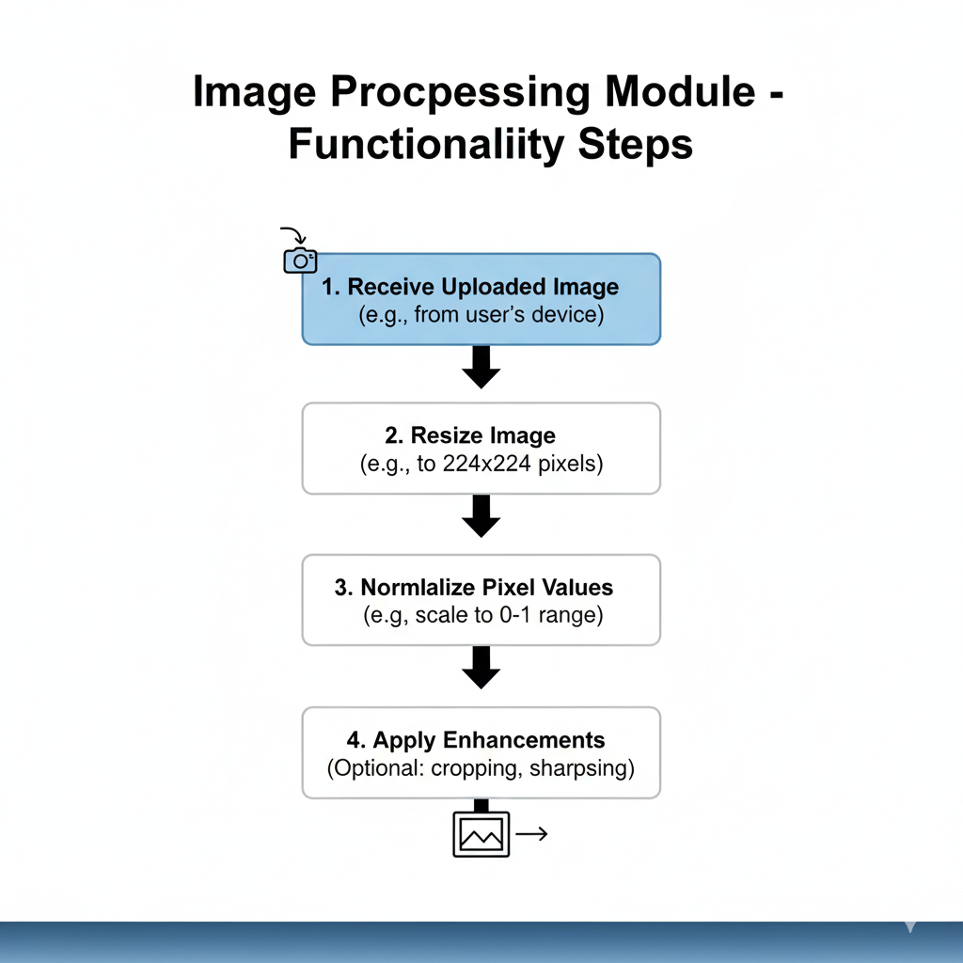
Modules

Slide 15
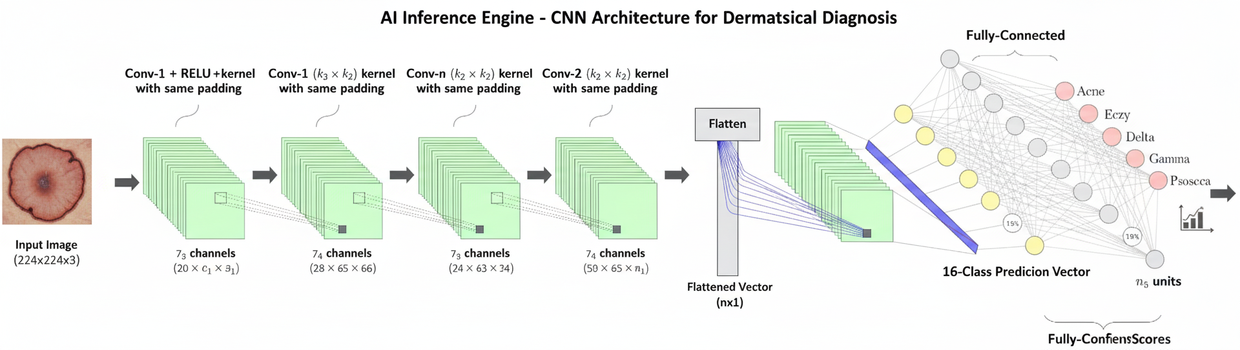
Modules
AI Inference Engine: Functionality: This is the core of the system. It takes the preprocessed image and feeds it into our pre-trained, 16-class Convolutional Neural Network (CNN) to generate a prediction vector containing confidence scores for each disease.

Slide 16
Modules
Backend: Model Training Pipeline
Data Loading & Preparation
Feature Extraction (ResNet50)
Data Balancing (SMOTE)
Model Training & Evaluation (Random Forest)
Model Persistence (Saving Model to Drive)
Frontend: Streamlit Application
Application Setup & Initialization
Model Loading
UI & Page Navigation
Inference Engine (Real-time Prediction)

Slide 17
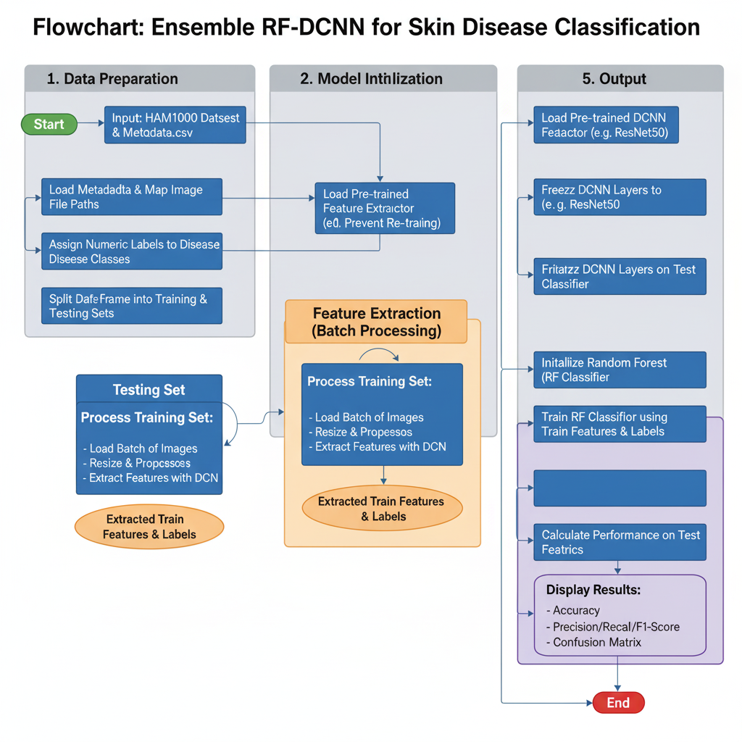
Algorithm-Flow Chart

Slide 18
Source Code Details:
Overall Architecture
Ensemble Model: The code implements a two-stage ensemble model called RF-DCNN, not a single end-to-end network.
Core Components: It combines a Deep Convolutional Neural Network (DCNN) for feature extraction with a Random Forest (RF) for classification.
Key Libraries & Environment
Environment: Designed to run in Google Colab.
Deep Learning: Uses TensorFlow and Keras to load the pre-trained ResNet50 model.
Machine Learning: Employs Scikit-learn for the RandomForestClassifier and for calculating evaluation metrics.
Data Manipulation: Leverages Pandas to manage the dataset's metadata and file paths.
Data Handling & Preprocessing
Dataset: Utilizes the HAM10000 dataset, which consists of a metadata CSV file and two image folders.
Image Resizing: All skin lesion images are resized to a standard 224x224 pixel resolution before processing.
Normalization: A specific preprocess input function for ResNet50 is used to normalize pixel values.
Memory Management
Batch Processing: To prevent RAM crashes in Colab, the code does not load all 10,000+ images at once.
Efficient Workflow: It processes images in small, manageable batches (e.g., 64 at a time) only during the feature extraction step, ensuring low memory consumption.
Model Components
Feature Extractor: A pre-trained ResNet50 model acts as a powerful feature extractor. Its final classification layer is removed, and its weights are frozen.
Classifier: A Random Forest Classifier is trained on the high-level features generated by ResNet50 to make the final prediction about the skin disease class.
Evaluation
Comprehensive Metrics: The model's performance is evaluated using:
Accuracy: The overall percentage of correct predictions.
Classification Report: Detailed Precision, Recall, and F1-Score for each disease class.
Confusion Matrix: A visual plot to analyze correct vs. incorrect predictions for each category.

Slide 19
Github Link
Github Link:
lakshmipriyanarayan/CSE_4_PSCS_49

Slide 20
Software and Hardware Requirements:
HARDWARE REQUIREMENTS:
Development PC/Laptop
CPU: Intel i5 / AMD Ryzen 5+
RAM: 16 GB
GPU: NVIDIA (6GB+ VRAM)
Storage: 512 GB+ SSD
Android Smartphone
Cloud Alternative: Google Colab (for GPU)
SOFTWARE REQUIREMENTS:
OS: Windows / macOS / Linux
Core Tools:
Visual Studio Code
Git & GitHub
Android Studio
AI Stack (Python):
Python
TensorFlow, Keras
TensorFlow Lite (TFLite)
OpenCV, Pillow
Scikit-learn
Jupyter Notebook

Slide 21
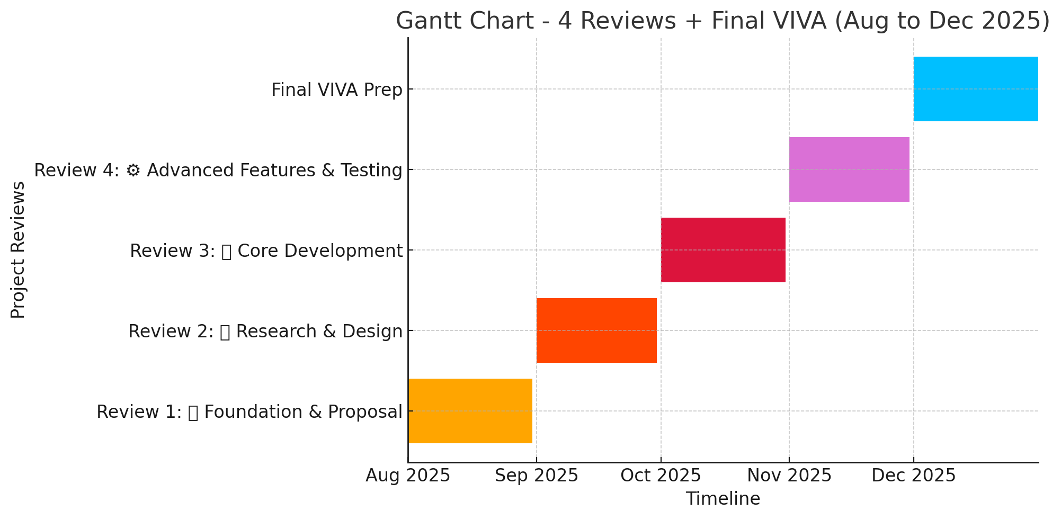
Timeline of the Project (Gantt Chart)

Slide 22
References (IEEE Paper format)
[1] M. Heenaye-Mamode Khan, N. G. Sahib-Kaudeer, M. Dayalen, F. Mahomedaly, G. R. Sinha, K. K. Nagwanshi, and A. Taylor, "Multi-Class Skin Problem Classification Using Deep Generative
Adversarial Network (DGAN)," Computational Intelligence and Neuroscience, vol. 2022, Article ID 1797471, 2022. doi: 10.1155/2022/1797471.
[2] A. Laouarem, C. Kara-Mohamed, E. Bourennane, and A. Hamdi-Cherif, "JILDYA-Net: An Efficient Lightweight Multi-Class Classification Architecture for Skin Lesions," International Journal of
Imaging Systems and Technology, vol. 35, p. e70102, 2025. doi: 10.1002/ima.70102.
[3] K. Rezaee and H. G. Zadeh, "Self-attention transformer unit-based deep learning framework for skin lesions classification in smart healthcare," Discover Applied Sciences, vol. 6, no. 3, 2024. doi:
10.1007/s42452-024-05655-1.
[4] N. Y. Vidal, K. Sidey, Y.-H. Kim, and D. E. Vidal, "Artificial intelligence in medicine - dermatology compared to other medical specialties in FDA-cleared software as medical device," Dermatology
Online Journal, vol. 29, no. 2, 2023. doi: 10.5070/D329260766.
[5] S. M. S. I. Badhon, S. A. Khushbu, N. C. Saha, et al., "Explainable AI for Skin Disease Classification Using Grad-CAM and Transfer Learning to Identify Contours,"
Preprints.org, 2024. doi: 10.20944/preprints202407.2556.v1.
[6] H. Wang, X. Wang, Y. Wang, et al., "Quantization-Aware Neuromorphic Architecture for Efficient Skin Disease Classification on Resource-Constrained Devices,"
arXiv preprint arXiv:2507.15958v1, 2025.
[7] A. Kalaivani and S. Karpagavalli, "Detection and classification of skin diseases with ensembles of deep learning networks in medical imaging," International Journal of Health Sciences,
vol. 6, no. S1, pp. 13624-13637, 2022. doi: 10.53730/ijhs.v6nS1.8402.
[8] S. Haggenmüller, E. Krieghoff-Henning, T. Jutzi, et al., "Digital Natives' Preferences on Mobile Artificial Intelligence Apps for Skin Cancer Diagnostics: Survey Study," JMIR mHealth and
uHealth, vol. 9, no. 8, p. e22909, 2021. doi: 10.2196/22909.
[9] T. Li, B. Li, Y. Jia, et al., "Application of multimodal deep learning in the auxiliary diagnosis and treatment of dermatological diseases," Intelligent Medicine, vol. 5, pp. 132-140, 2025.
doi: 10.1016/j.imed.2024.10.002.
[10] M. Kauke-Navarro, L. Huelsboemer, F. J. Klimitz, et al., "A comparative analysis of lesional skin, sentinel flap, and mucosal biopsies in assessing acute face transplant rejection
," Frontiers in Immunology, vol. 16, p. 1562024, 2025. doi: 10.3389/fimmu.2025.1562024.

Slide 23


